Slide 1
Reimagining Higher Education as a Field of Study: An Analysis of 495 Academic Programs, Research Centers, and Institutes across 48 Countries
August 4, 2018
Roy Y. Chan
*Download FREE Inventory Book: http://iu.box.com/v/HigherEducationInventory
WERA 2018 Inaugural Congress
Notes:
Qualitative researchers have often seen validity and ethics are separate and distinct;
Validity and Ethics are reflective understanding, and are useful in the process of making meaning (or producing authentic knowledge).
Who am I? What am I? Where am I? What does all that mean for my research project?

Slide 2
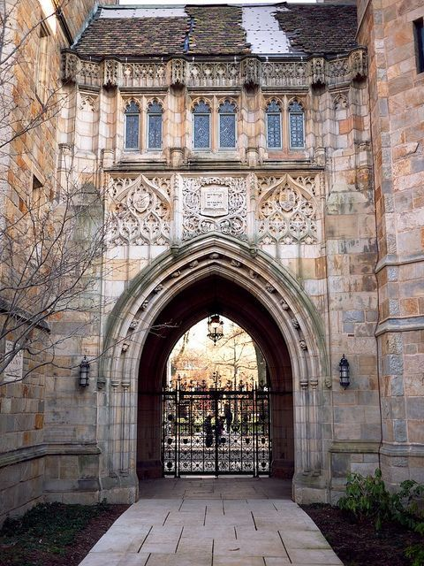
Overview
About the Higher Education Inventory Project
Literature Review
Methodology
Data Sources
Criteria for Inclusion
Findings
Discussion
Conclusion
Q & A

Slide 3
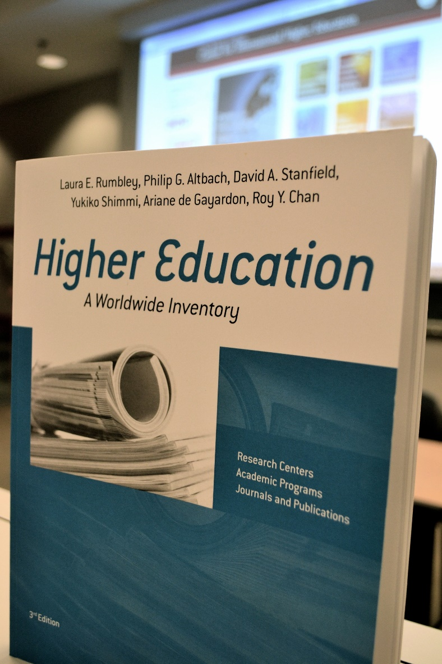
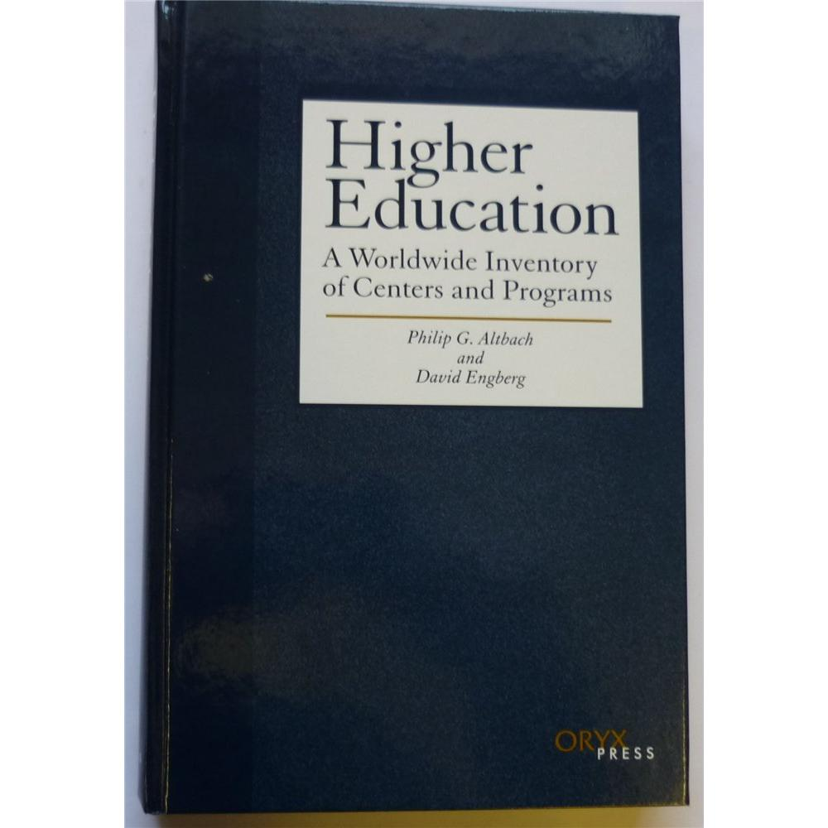
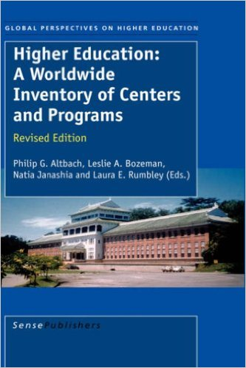
Higher Education Inventory

Slide 4
The Emergence of Higher Education as a Field of Research, 1947-2017
Higher education as a field of study emerged in the mid-20th century
Burton Clark, Martin Trow, Clark Kerr, and S. M. Lipset
Major Factors:
Massification of higher education;
University competitiveness
Lack of training and knowledge of higher education from faculty members
Increased demand for data on higher education and their impact on the economy (Tight, 2004)

Slide 5
The Emergence of Higher Education as a Field of Research, 1947-2017
Differentiation and diversification in higher education systems
Global knowledge economy (“knowledge revolution”) for 21st century jobs (Grubb, 2003)
Ph.D. production in all fields of studies (Addae-Mensah, 2013)
Democratization of access to higher education (Bastedo & Gumport, 2003)
Corportization of higher education (Croxford & Raffle, 2014)

Slide 6
The Globalization of Higher Education, 1947-2017
Rise of Research Centers/Academic Programs
Blackwell & Blackmore, 2003; Altbach et al, 2006
Rise of Professional Associations and Journals
Altbach & Emgnerg, 2001; Hutchinson & Lovell, 2004.
Rise of Institutional Research
Over 10,000 IR offices worldwide out of 18,000 colleges and universities worldwide
Rise of Transnational Higher Education Institutions
Branch Campuses, International Joint Degree and Dual Programs, International MOOCs (Kinser & Lane, 2016)

Slide 7
Theoretical Framework
Social Origins Theory - higher education sector is shaped by the country’s political, cultural, religious and economic history and norms (Moore, 1966).
1) The Liberal Model
2) The Social Democratic Model
3) The Corporatist Model
4) The Statist Model
World Culture Theory and World-Systems Analysis – the rise of higher education programs/institutes occur due to the power of a world culture originated from the West, and justifies educational expansion from human capital perspective (Ramirez, 2012).

Slide 8
Methodology
Survey Data Collected: March 2013 – March 2014
Questionnaires were taken from the 2006 Higher Education WorldWide Inventory (2nd edition)
Sent e-mail to program directors/chairs to 277 programs/centers around the world
18 questions total. Focused on three types:
1) Academic Programs
2) Centers or Institutes
3) Journals and Publications

Slide 9
Data Sources
170 of the 217 research centers/institutes (78%)
165 of the 277 (60%) graduate-level higher education programs
Those who did not responded to survey:
U.S.: Used ASHE CAHELP (2013) data on U.S. graduate programs in higher education
China: Used Shanghai Jiao Tong University GSE data

Slide 10
Criteria for Inclusion
Academic Programs – 1) Focused on teaching and offering a formal degree, 2) At least one full-time faculty member, 3) Award a graduate-level degree
Centers or Institutes – 1) Primarily focused on higher education research, policy analysis, or other activities, 2) Have at least one full-time staff, 3) Have a budget
Journals/Publications – 1) Primarily focus on issues of higher education, 2) Recognized as a credible source of information

Slide 11
Findings

Slide 12
Findings

Slide 13
Findings

Slide 14
Findings

Slide 15
Findings

Slide 16
Findings

Slide 17
Discussion
Higher education scholarship is accessible in mostly English-speaking developed, wealthiest countries.
Statist Model (strong elites; fee driven; relies on government support; weakened middle class)
However, most developing countries (except China) do not have access to research centers/institutes and programs
Liberal Model (low level of government spending on higher education; larger higher education sector)

Slide 18
Discussion
From the world culture perspective, countries develop higher education programs/institutes not because it satisfies functional needs but also makes them more legitimate to enact a nation-state identity.
Credentialism intensifies status group competitions leading to the expansion of higher education programs/institutes in developing and transitional economies.

Slide 19
Conclusion
The world’s wealthiest countries and regions occupies a position of significant privilege and power in regards to access to higher education research, analysis, and trained human capital.
Of the 450+ programs/centers globally, nearly 66 percent higher education programs/centers are in the U.S., China, and U.K. (Rumbley et al., 2015).
Mainland China is the most active developer, with 28 new research centers/institutes established between 2000 and 2015

Slide 20
Questions? Comments?
Roy Y. Chan: rychan@indiana.edu
*Download FREE Inventory Book: http://iu.box.com/v/HigherEducationInventory

Slide 21
Further Studies
Future comparative research should examine the role of the higher education network worldwide on the growing field of higher education studies.
Leadership training and professional development in developing countries.
Research centers and journal/publication activities in developing countries.
Open access journals on knowledge transfer and consumption in developing countries.

