Slide 1
Who are the 21st Century Scholars at Indiana University Bloomington?
IU 21st Century Scholars Program, Office of the Vice President for Diversity, Equity, and Multicultural Affairs (OVPDEMA), Indiana University Bloomington
Roy Y. Chan (rychan@indiana.edu)
Special Projects Coordinator, IU 21st Century Scholars Program
IU FIRST-YEAR EXPERIENCE (FYE) 2018 BI-ANNUAL CONFERENCE

Slide 2
Outline
WHO ARE THE 21st CENTURY SCHOLARS AT IUB?
Indiana 21st Century Scholars Program
IUB Class of 2021: Scholar Profiles
IUB Class of 2021: Academic Profiles
IUB 21st Century Scholars: A 10-year Longitudinal Analysis between 2007-08 and 2017-18
Summary of Results
Q & A
Discussion Groups
Share Best Practices

Slide 3
What is the Indiana 21st Century Scholars Program?
WHO ARE THE 21st CENTURY SCHOLARS AT IUB?
Early commitment college promise program (need-based)
Funds up to 4-years of tuition (first-dollar)
Underserved students = Low-income, first-generation, and/or ethnic minority
PURPOSE: To increase the degree attainment rates of “underserved” populations to 60 percent by 2025 (Lumina Foundation, 2018)

Slide 4
Who are the 21st Century Scholars at IU Bloomington?: Class of 2021 Profiles
WHO ARE THE 21st CENTURY SCHOLARS AT IUB?
831 Freshmen IUB Scholars
60% Female
42% First-Generation
1175 Average SAT Score
3.63 Average High School Cumulative GPA
50% Students of Color
~ 85% Receive Institutional Aid (i.e., Covenant)
90% Scholars Return Back to IUB After First-Year
100% Indiana Residents

Slide 5
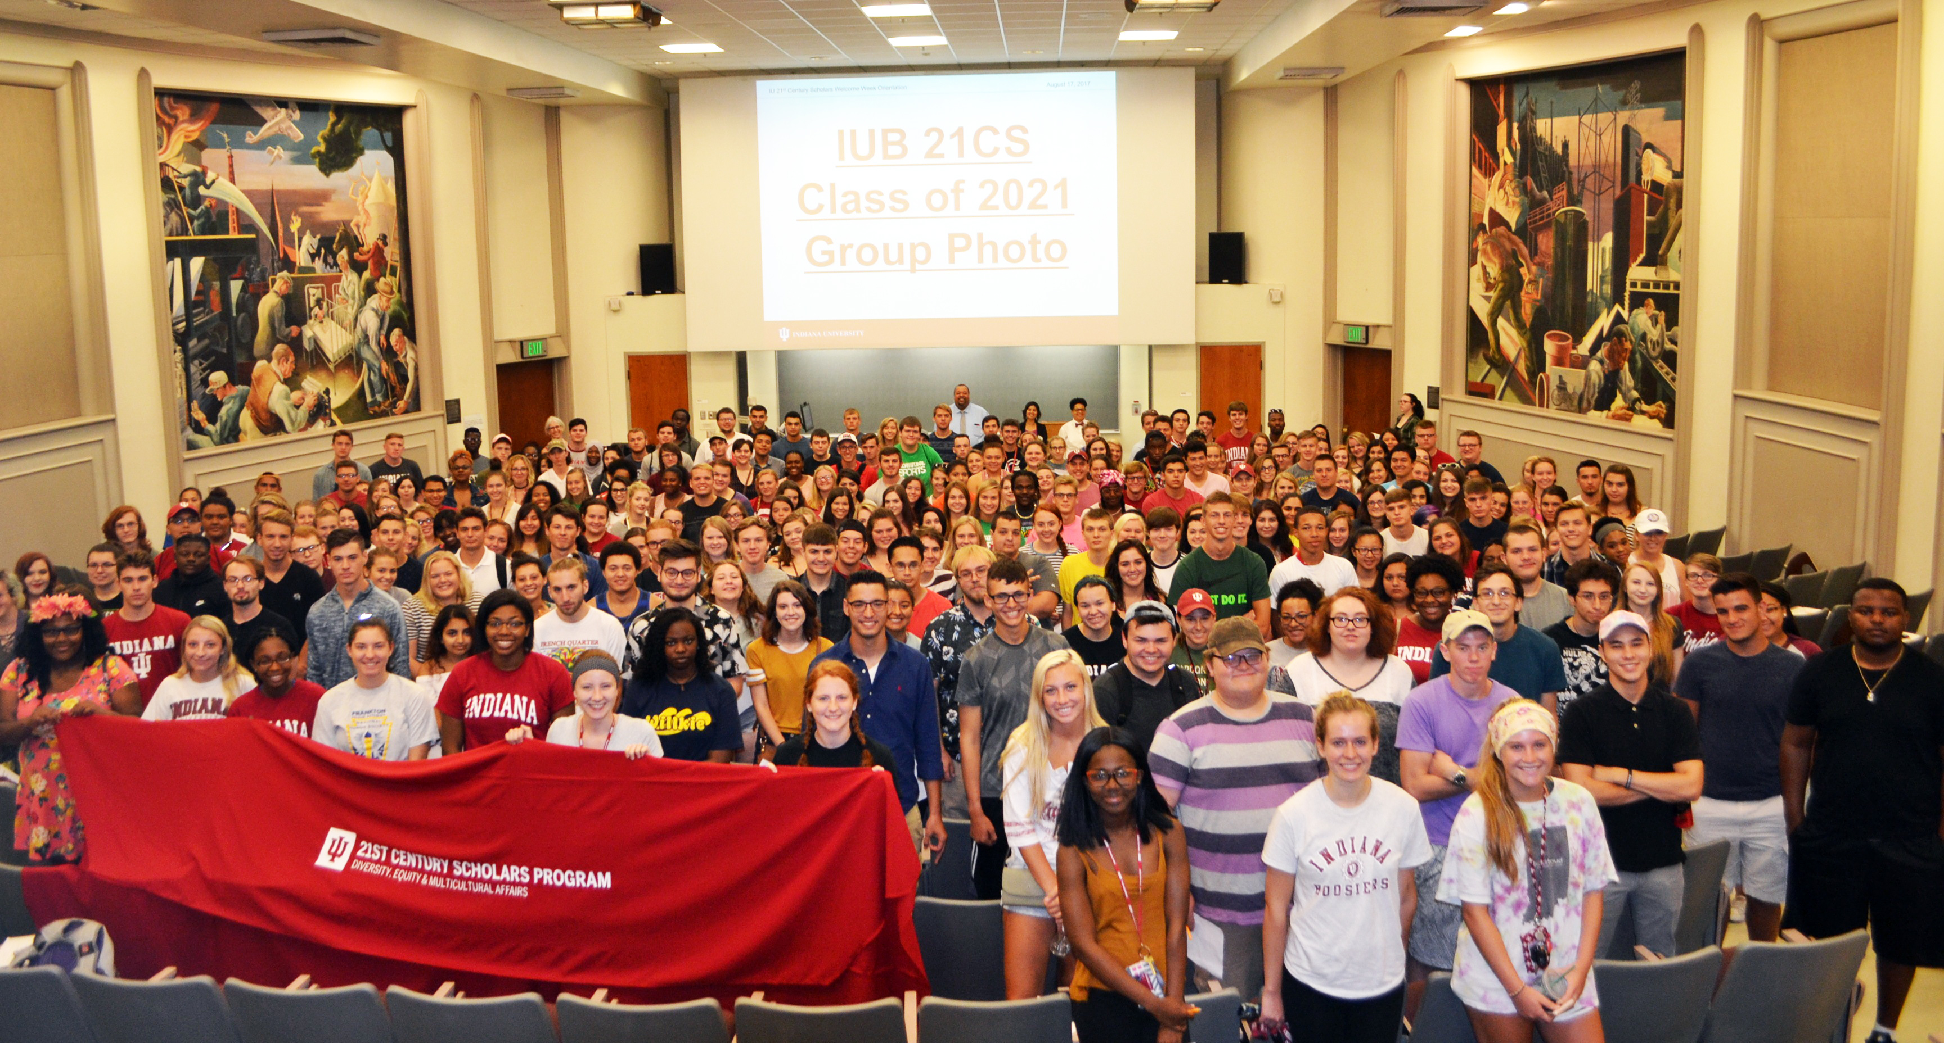
Who are the 21st Century Scholars at IU Bloomington?: Class of 2021 Profiles
WHO ARE THE 21st CENTURY SCHOLARS AT IUB?

Slide 6
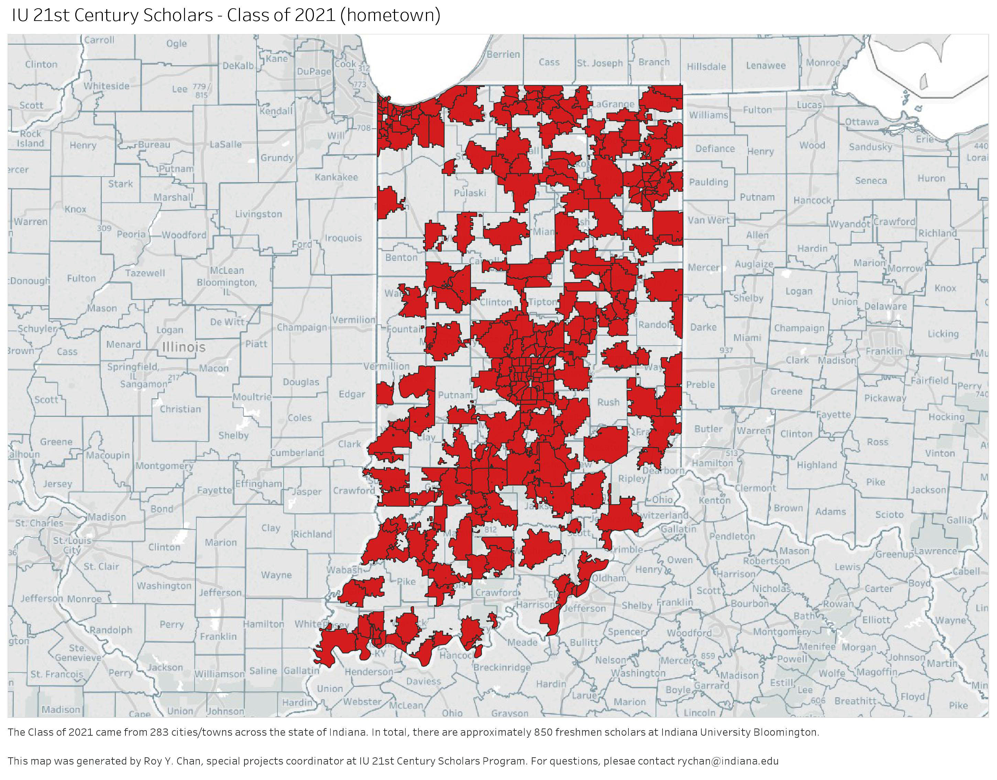
WHO ARE THE 21st CENTURY SCHOLARS AT IUB?

Slide 7
Who are the 21st Century Scholars at IUB?: Academic Profiles
The 30/60/90 Day Plan for IU OVPDEMA Alumni Affiliate Groups
Top 5 Majors: 1) Biology, 2) Nursing, 3) Management/Marketing, 4) Psychology, and 5) Social Work
Top 5 Colleges/Schools: 1) College of Arts & Sciences, 2) Kelley School of Business, 3) School of Public Health, 4) School of Public and Environmental Affairs (SPEA), and 5) School of Informatics, Computing, and Engineering
Summer 2017 OVPDEMA Study Abroad Recipients: 24 out of 35 scholars studied abroad through IU OVPDEMA either in Brazil or India
7 scholars were elected and inducted to Phi Beta Kappa (PBK) Society for the IU Class of 2017
Largest student support services at IUB in terms of student enrollment
$25 million scholarship awarded to 2,588 scholars during the 2015-16 academic year at IUB (ICHE, 2017)

Slide 8
So, who are the 21st Century Scholars at IUB?? Let’s look at longitudinal data between 2007-08 and 2017-18 academic year analyzed by Roy Y. Chan
WHO ARE THE 21st CENTURY SCHOLARS AT IUB?

Slide 9
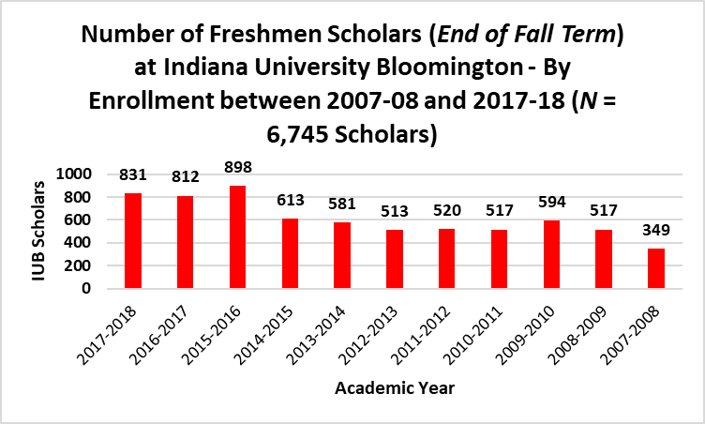
WHO ARE THE 21st CENTURY SCHOLARS AT IUB?

Slide 10
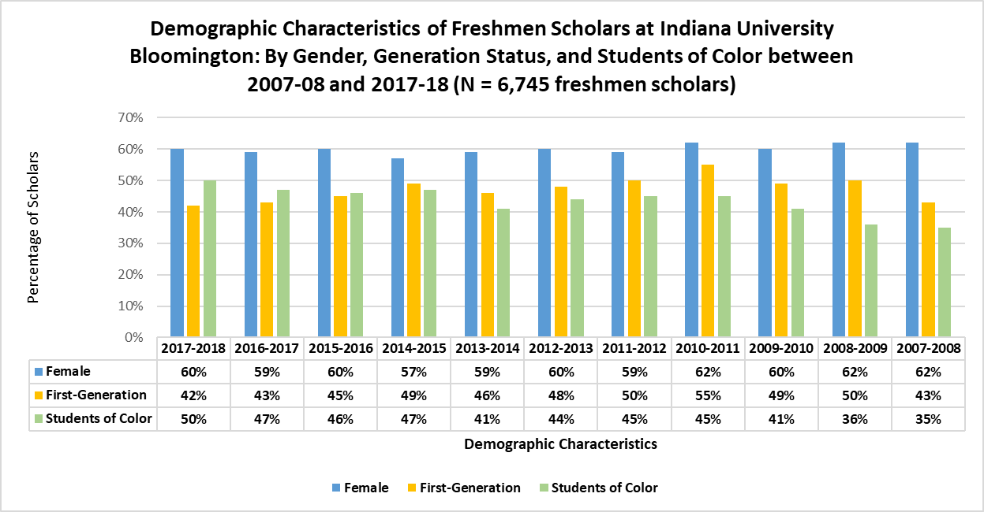
WHO ARE THE 21st CENTURY SCHOLARS AT IUB?

Slide 11
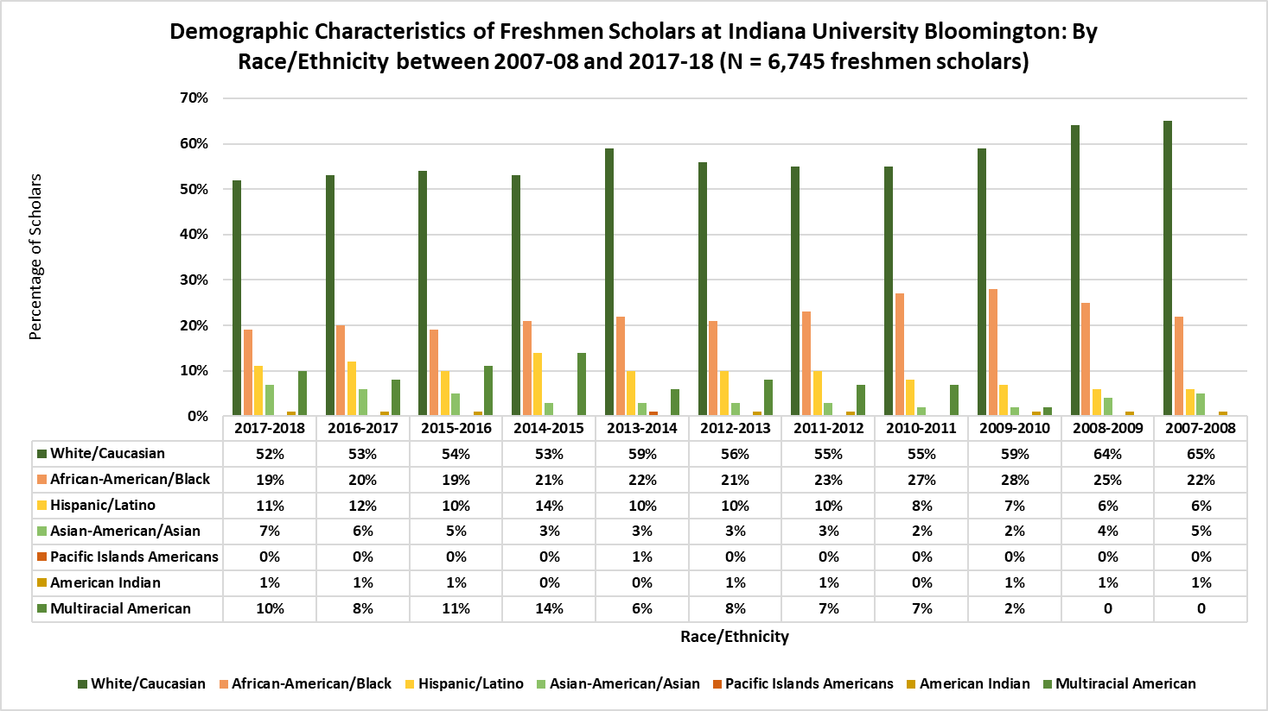
WHO ARE THE 21st CENTURY SCHOLARS AT IUB?

Slide 12
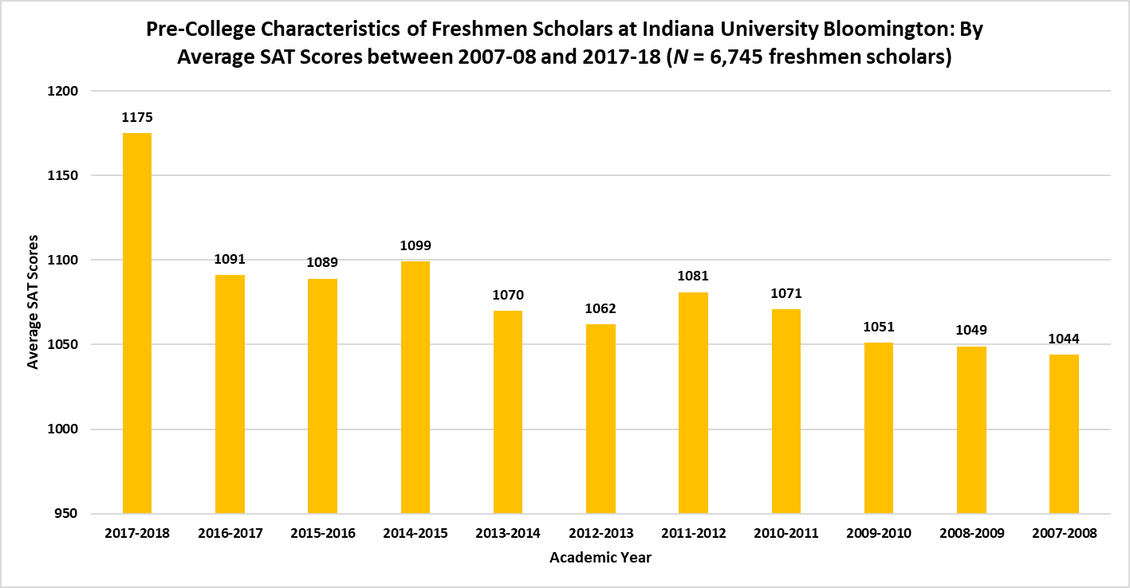
WHO ARE THE 21st CENTURY SCHOLARS AT IUB?

Slide 13
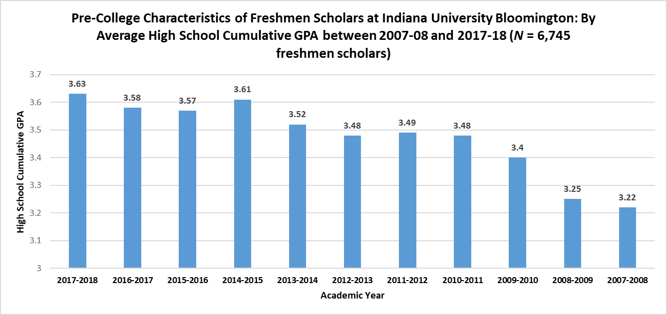
WHO ARE THE 21st CENTURY SCHOLARS AT IUB?

Slide 14
Summary of Results
WHO ARE THE 21st CENTURY SCHOLARS AT IUB?
The percentage of students of color of first-year IUB 21st Century Scholars was 50% for the 2017-2018 academic year, a 15% increase compared with the 2007-2008 academic year.
Total freshmen enrollment of IUB 21st Century Scholars Class of 2021 has increased by more than 250% since 2007.
The 21st Century Scholars Class of 2021 at IUB are the most competitive cohort since 2007 in terms of SAT score and average cumulative high school GPA.
The percentage of first-generation IUB 21st Century Scholars as well as the number of female students has stayed relatively the same between 2007-08 and 2017-18.
The proportion of Caucasian/White IUB 21st Century Scholars has decreased by 13% since 2007.
Hispanic/Latino IUB 21st Century Scholars is the fastest growing ethnic minority group, having more than doubled since 2007.

Slide 15
Questions? Comments?
WHO ARE THE 21st CENTURY SCHOLARS AT IUB??
i
Roy Y. Chan, M.A.
Special Projects Coordinator, IU 21st Century Scholars Program
rychan@indiana.edu
go.iu.edu/21st

Slide 16
Discussion Groups (5-10 minutes)
WHO ARE THE 21st CENTURY SCHOLARS AT IUB?
1) What were your overall thoughts of the demographic, geographic, and pre-college characteristics of first-year 21st Century Scholars at IUB?
2) Name one piece of information that stood out to you the most. Why?
3) What, if any, would you change/do when working with 21st Century Scholars at IUB?

Slide 17
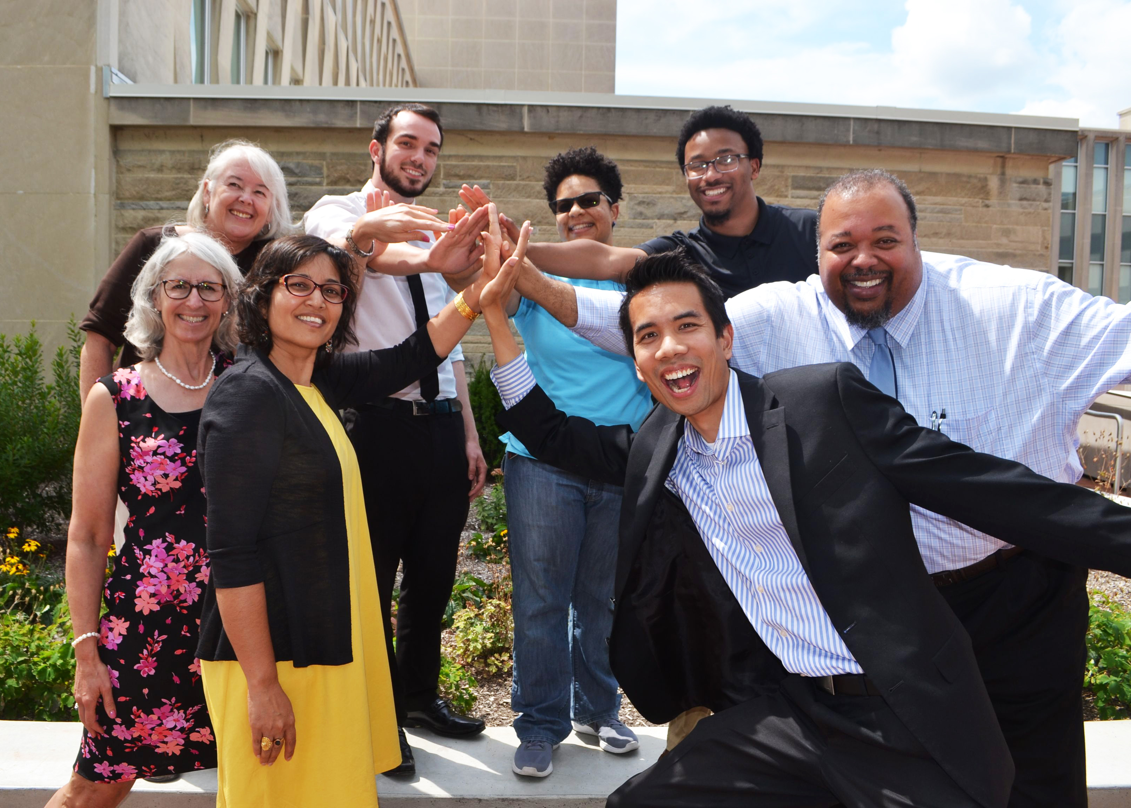
Share Best Practices with Colleagues
WHO ARE THE 21st CENTURY SCHOLARS AT IUB?

