Slide 1
Engaging Young Alumni: Millennials Participation in Homecoming Events at Indiana University, Bloomington
Roy Y. Chan
Ph.D. candidate
School of Education
Indiana University
rychan@indiana.edu
2016 NASPA Student Affairs Fundraising Conference
July 30, 2016

Slide 2
Overview
Literature Review
Millennials and Higher Education Philanthropy
Research Questions
Demographics
Findings/Discussion
Recommendations for Practitioners
Refection Questions (15-20 mins)
Group Discussion
Share Ideas to Conference Participants
Q&A

Slide 3
Literature Review Millennials and Higher Education Philanthropy
Millennials (defined as age 18 to 35) is now the largest generation in the U.S. population and will make up 75 percent of the workplace by 2025 (U.S. Census Bureau, 2015)
Millennials are the most educated, diverse, and tech-savvy generation in U.S. history (Pew Research Center, 2015).
63% already have a bachelor’s degree (NCES, 2015).
Millennial alumni giving rates to higher education have declined (Eduventures, 2014).
More than 50% of Millennials had never given money to their alma mater (The Chronicle of Higher Education & Achieve, 2015).

Slide 4
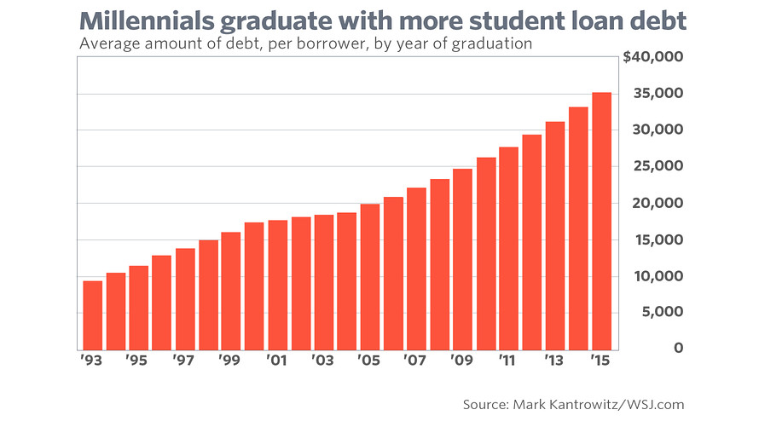
Literature Review Millennials and Student Debt

Slide 5
Literature Review Millennials and Higher Education Philanthropy
75 percent of Millennial alumni are more likely to donate to their favorite charity before donating to their alma mater (The Chronicle of Higher Education & Achieve, 2015).
WHY: *Lack of Trust and Confidence with Alma Mater (Drezner & Anderson-Long, 2015); Rising Student Loan Debt, Increasing Tuition Cost; Large Endowments; Unemployment Underemployment; Negative Student Experience
Yet 82% of Millennial alumni who volunteered for their college said they will donate financially (The Chronicle of Higher Education & Achieve, 2015).
WHY: Community service and civic engagement impact Millennial alumni philanthropic behavior (Avalos, Sax, & Astin, 1999)

Slide 6
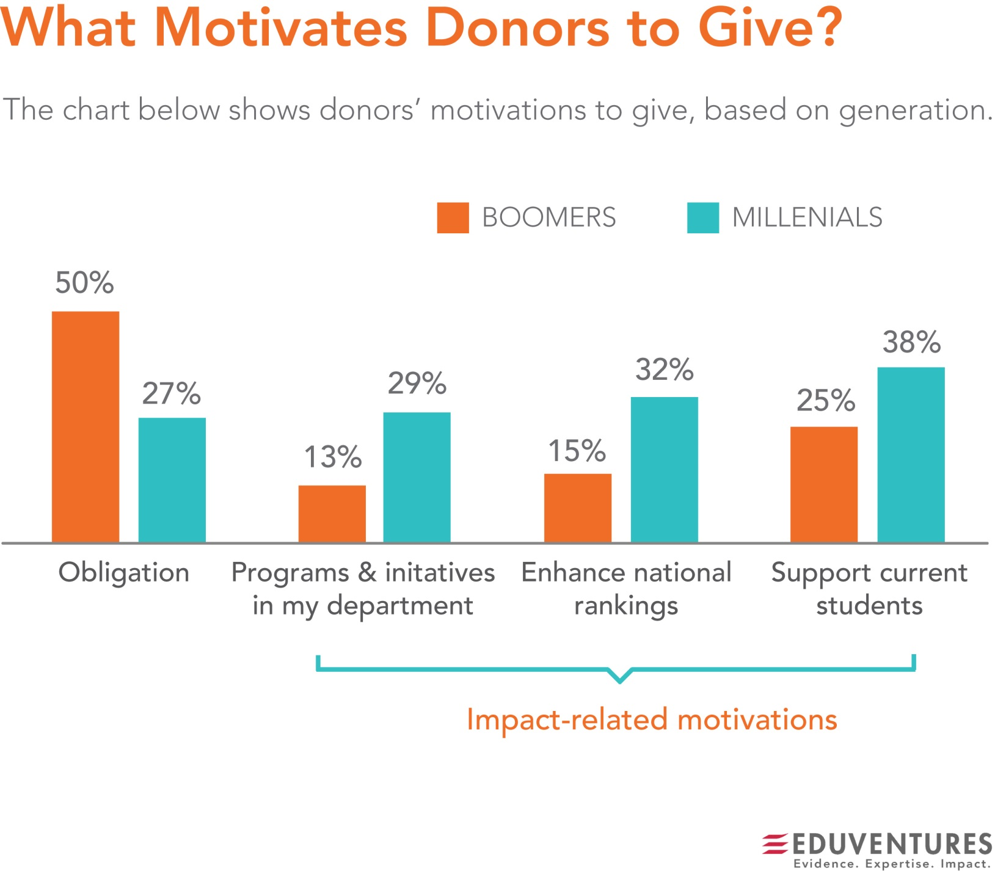
Literature Review Why do Millennials give to higher education?
Source: Eduventures, 2014

Slide 7
Research Questions
1) What do alumni, specifically the Millennial generation, report about their intent to participate in the 2015 Homecoming activities at Indiana University, Bloomington?
2) Is there a significant relationship between demographic factors (age, gender, geographic location) and reported alumni engagement at Indiana University, Bloomington?
3) How do Millennial alumni participation in IU Homecoming events affect prosocial behaviors?

Slide 8
Theoretical Framework
Social Integration Theory
Participation in alumni events is a desirable prosocial behavior (Wilson & Musick, 1998)
Socialization Theory
Alumni who value the importance of volunteering and giving will encourage others to participation in prosocial behavior (Grusex & Hastings, 2008).

Slide 9
Demographics
Indiana University Alumni Association (IUAA) 2015 Returning to Campus Survey
June 25, 2015 to July 9, 2015 (10 minute online survey)
15 Questions
http://alumni.indiana.edu/panel
763 out of 962 IU alumni participants
79% completion rate
155 are identified as Millennials (defined as 18-34 age)

Slide 10
Demographics

Slide 11
Findings

Slide 12
Findings

Slide 13
Findings

Slide 14
Findings

Slide 15
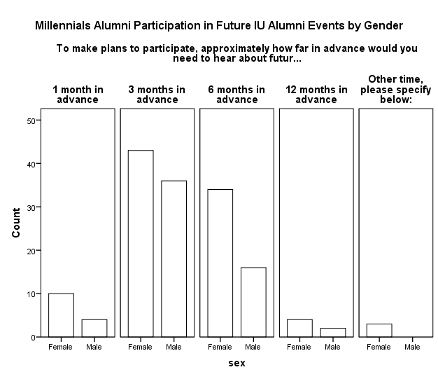
Findings

Slide 16
Results from Data
IU Millennial alumni are very unlikely to attend Homecoming Weekend regardless of age, gender, or geographical location.
Only one in 10 young alumni are likely to return for IUB Homecoming 2015.
Less than a quarter of Millennials visited the IUB campus in the last 12 months.
Primary reason not to attend: 1) Friends are not attending, 2) Activities are not appealing, and 3) Geographical distance
Primary reason to attend: 1) Watch the football game, 2) See how campus has changed/hasn’t changed, and 3) To see friends and family

Slide 17
Discussion
However, it’s STILL worth connecting with Millennial alumni even if they aren’t making financial donations or attending alumni events.
“Relationship management”
E.G., Remind young alumni of their positive experience as an undergraduate student (Bresciani, Bump, & Heffernan, 2010)
E.G., Create a diverse set of young alumni activities more than just a sports event, swags, and pub crawls
If young alumni have the sense that the university is behind their professional growth, they’ll be more likely to give back in future years.
“Emotional connection” and “Loyalty”
Attachment is a key predictor to alumni giving/involvement

Slide 18
Recommendations for Practitioners
Leverage social media and crowdfunding (Funderful; iModules; GiveCampus; Ologie)
E.G. Make digital communications/mobile giving personal such as, college scholarship fund (first generation; LGBTQ)
Encourage young alumni to volunteer and ask for their time instead of money (It’s socialization process!)
E.G., Student advancement/philanthropy programs (senior class giving, ambassador programs, co-curricular activities)
Collect and use data to identify patterns of alumni involvement and giving history
E.G., Race, Graduation, Prior-Student Involvement (Drezner, 2009)
Hire an Associate Director of Young Alumni Programs
Provide FREE career support/guidance and networking support for young alumni
E.G., Free IU alumni membership for first 5 years; Free IU alumni parking pass; Free IU coaching services; Discounted IU hotels

Slide 19
Group Discussion/Reflection Questions
3-4 groups (15 mins)
1) Introduce yourself
2) How do you or your office engage with young alumni? What work? What did not work?
3) What tools/strategies you or your office hope to use to better identify, cultivate, and solicit young alumni to university advancement?

Slide 20
Questions? Comments?
Roy Y. Chan
Ph.D. candidate, Indiana University
Founder & CEO, Philanthropy for America
rychan@indiana.edu
www.philanthropyforamerica.org
@royalroyce86

